Slide 1
A brand is a name, term, design, symbol or any other feature that distinguishes one seller's good or service from those of other seller

Slide 2
What is your identity
What are your core values ?
What do you stand for?
What personality traits do you have ?
How do you want to be perceived
It gives direction, purpose and meaning to your life & that is your identity

Slide 3
What is identity of Baba Amte
Core value: Honesty, Integrity, compassion
Stands for : Social service
Personality traits : Common Indian, Simple living
Perceived by people: As LOK SEVAK,
This gives meaning purpose and direction to his life

Slide 4
What is brand identity?
What are core values of brand?
What does brand stand for?
What are personality traits of brand
How does strategist want brand to be perceived?
It gives meaning purpose and direction to the brand

Slide 5
What is brand identity of
Harley-Davidson
Core value : Roughness, Toughness,
Stands for : Superior Bikes design, Higher engine capacity,
Brand personality : Macho
Perceived by people : Expression of freedom, Rebellious attitude, Carefree

Slide 6
Definition of brand identity
Brand Identity is a unique set of brand associations that the brand strategist aspires to create or maintain.
These associations represent what the brand stand for and imply a promise to customers from the organization members.

Slide 7
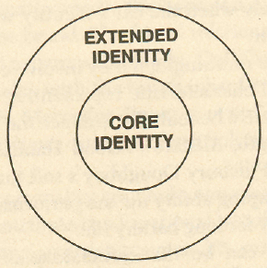
Brand identity structure

Slide 8
Core identity
Represents the timeless essence of the brand
It is mostly constant as the brand travels to new markets and new products
It forms credibility for your brand
Sometimes it is made part of mission statements of the companies

Slide 9
Examples of core identity
McDonald’s
Value Offering, Quality, Service, Cleanliness,
Nike
User, Performance
Close Up
Fresh breath

Slide 10
Extended identity
Includes elements that provide texture and completeness
It fills in the picture of brand, adding details that help portray what the brand stands for
It is important element of brand’s marketing program that should be visible
A larger extended identity makes brand more interesting & complex to describe and makes very stronger brands

Slide 11
Examples of extended identity
McDonald’s
Sub-brands, Logo, Characters, Convenience
Nike
Personality, Logo, Sub-brands, Slogan, Endorsers
Close Up
Variants, Packaging

Slide 12
Brand’s Value Proposition
A brand’s value proposition is a statement of the functional, emotional and self-expressive benefits delivered by the brand that provide value to the customer

Slide 13
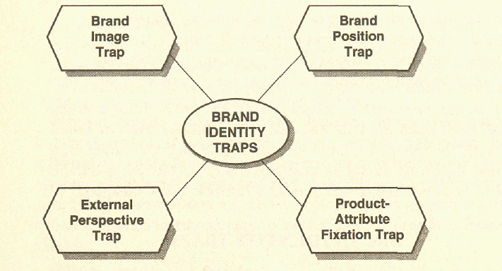
Brand identity traps

Slide 14
Brand identity traps
Brand position trap
Definition of brad position: A brand position is the part of the brand identity and value proposition that is to be actively communicated to the target audience and that demonstrates an advantage over competing brands.
The trap occurs when the focus is on product attributes rather than brand building activities (like brand personality, symbol, organization)
This inhibits evolution of a full-fledged brand identity

Slide 15
Brand identity traps
Brand image trap :
BRAND IMAGE :How the brand is now perceived
BRAND IDENTITY : How strategists want the brand to be perceived
Brand image trap occurs when brand image becomes the brand identity

Slide 16
Brand identity traps
External Perspective Trap
When most organizations fail to internally communicate the vision and values of their brand
Ask anyone within your organization what your brand stands for - if you get a blank stare or a numerical response (like sales goal)

Slide 17
Brand identity traps
The product attribute fixation trap
The failure to distinguish between a product and a brand
When company focuses on tangible attributes rather than intangible

Slide 18
How to avoid brand traps
To help break out of the traps, brand strategists should consider the brand as:
  Product
  Organization
  Person
  Symbol

Slide 19
Brand Identity Planning
Extended
core
Brand As Product
Product Scope
Product Attributes
Quality/Value
Uses
Users
Country
Brand as Organization
Organizational Attributes
Local vs. Global
Brand As Person
Personality
Brand-customer relationship
Brand As Symbol
Visual Imagery and metaphors
Brand Heritage

Slide 20


Extended
core
Brand As Product
Hospitality
Comfort, great food, ambience
World class
Meeting, conference ,wedding
Business people, film people
India
Brand as Organization
Transparent,
Hardworking
Global View
Brand As Person
Honest, Courteous
Always there for customer
Brand As Symbol
Royal, elegant
old

Slide 21


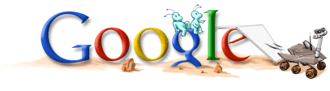
Extended
core
Brand As Product
Search
Fast, comprehensive
“The best”
Find anything: research to fun
Everyone
International
Brand as Organization
Hardworking, fun, cult
Global view
Brand As Person
Honest, but playful.
Always there for you.
Brand As Symbol
Simple design, basic html. Logo is not sacred.
“old internet’

